Slide 1
Overview of Prism-MW
CS 795 / SWE 699
Sam Malek
Spring 2010

Slide 2
Prism-MW
A simple and extensible architectural middleware, i.e., a framework of abstract classes for architectural concepts such as (sub)systems, components, connectors, and events. The middleware supports composition of arbitrarily complex components and connectors.
Objectives
“Programming”
Architectural abstractions directly reified in the implementation
“Small”
Efficiency demanded by resource constraints
“Many”
Scalability in the numbers of devices, threads, components, connectors, events
Extensibility to support awareness, mobility, reconfigurability, security, delivery guarantees

Slide 3
Prism: Programming-in-the-Small-and-Many

Slide 4
Prism Challenges
Resource constraints
Demand highly efficient computation, communication, and memory footprint
Demand unorthodox solutions
e.g., off-loading components
Hardware and software heterogeneity
Proprietary operating systems
Dialects of programming languages
Device-specific data formats
Lack of support for inter-device interaction
Lack of support for code mobility

Slide 5
From architecture to implementation
Architectures provide high-level concepts
Components, connectors, ports, events, configurations
Programming languages provide low-level constructs
Variables, arrays, pointers, procedures, objects
Bridging the two often is an art-form
Middleware can help “split the difference”
Existing middleware technologies
Support some architectural concepts (e.g., components, events)
but not others (e.g., configurations)
Impose particular architectural styles
End result ➔ architectural erosion
Architecture does not match the implementation
What is needed is “architectural middleware”

Slide 6
Prism-MW
An architectural middleware for embedded systems
Supports architecture-based software development
Architecture-based software development is the implementation of a software system in terms of its architectural elements
Efficient
Scalable
Flexible and Extensible
Allows us to cope with heterogeneity
Supports arbitrary complex architectural styles

Slide 7
Architectural Middleware
Natively support architectural concepts as middleware constructs
Include system design support
Typically via an accompanying ADL and analysis tools
Support round-trip development
From architecture to implementation and back
Support automated transformation of architectural models to implementations
i.e., dependable implementation
Examples
ArchJava
Aura
c2.fw
Prism-MW

Slide 8
Prism-MW

Slide 9
Prism-MW

Slide 10
Using Prism-MW
class DemoArch {
static public void main(String argv[]) {
Architecture arch = new Architecture ("DEMO");
Architecture - DEMO
Component A
Component B
// create components
ComponentA a = new ComponentA ("A");
ComponentB b = new ComponentB ("B");
ComponentD d = new ComponentD ("D");
Connector C
// create connectors
Connector conn = new Connector("C");
C
// add components and connectors
arch.addComponent(a);
arch.addComponent(b);
arch.addComponent(d);
arch.addConnector(conn);
Component D
// establish the interconnections
arch.weld(a, conn);
arch.weld(b, conn);
arch.weld(conn, d)
}
}
Connector C
Component A
Component B
Component D
C

Slide 11
Using Prism-MW
Component D sends an event
Event e = new Event ("Event_D");
e.addParameter("param_1", p1);
send (e);
Architecture - DEMO
Send (e1)
Component A
Component B
Component B handles the event and sends a response
public void handle(Event e)
{
if (e.equals("Event_D")) {
...
Event e1= new Event("Response_to_D");
e1.addParameter("response", resp);
send(e1);
}...
}
Connector C
C
Send (e)
Component D

Slide 12
Event Dispatching
Scaffold
Thread Pool
Adaptation of an existing worker thread pool technique
Topology based routing
Single event queue for both locally and remotely generated events
Easy redeployment and redistribution of applications onto different hardware configurations
E₂
Component
A
Component B
Component
B
handle Event
E
2
Connector
C
X
X
E
E
E
E
E
E
1
2
3
4
5
send Event
Component
D
E
Notes:
Role of connectors in mobility

Slide 13
Prism-MW Performance
Efficiency
1750 SLOC
4600 B for the core
160 B per component
240 B per connector
70 B per weld
160 B per event
240 B per event parameter
…
100 001 components
100 000 connectors
Total event roundtrip time 2.7 sec
Scalability
Numbers of devices, threads and events not limited by Prism-MW
Numbers of components and connectors
available_memory – middleware_size
average_element_size

Slide 14
Prism-MW Benchmarks on a PC

Slide 15
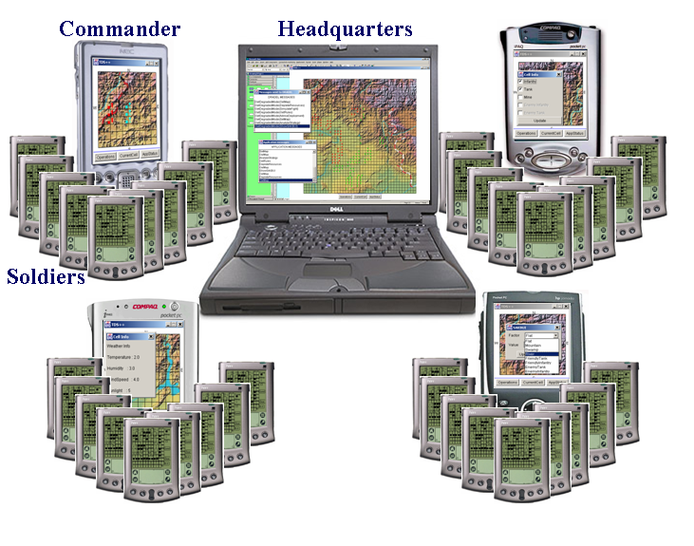
Prism-MW has been adopted by several industry partners
Troops Deployment Simulation
US Army
MIDAS
Bosch Research and Technology Center

Slide 16
Architecture of MIDAS

Slide 17
Recent Progress

